Slide 1
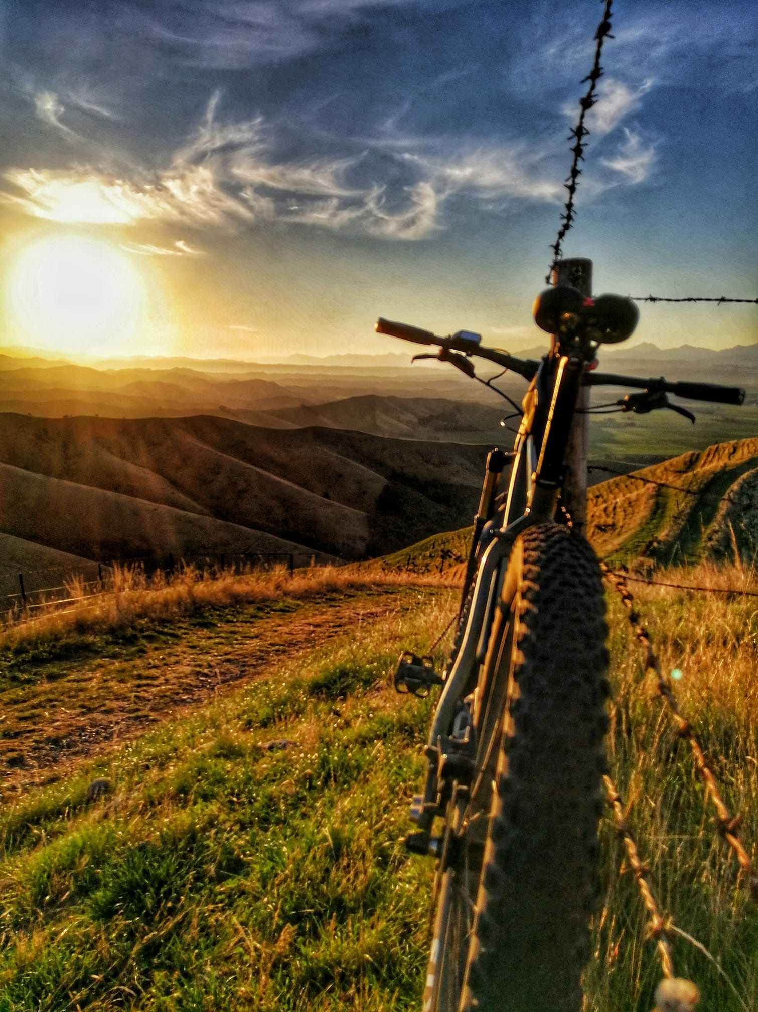
CYCLIST BIKE-SHARE ANALYSIS
SIDDHI PANDEY
JULY 2022

Slide 2
BACKGROUND
In 2016, Cyclistic launched a successful bike-share offering. Since then, the program has grown to a fleet of 5,824 bicycles that are geo-tracked and locked into a network of 692 stations across Chicago. The bikes can be unlocked from one station and returned to any other station in the system anytime.
There are two types of cyclists, those who purchase casual ticket and those who purchase annual membership. The marketing team believes that maximizing the number of annual members will be key to future growth. Rather than creating a marketing campaign that targets all-new customers, they believes there is a very good chance to convert casual riders into members.

Slide 3
TABLE OF CONTENT
Objective
Summary of analysis
Recommendation
visualization
appendix
Business task

Slide 4
OBJECTIVE
How do Annual Members and Casual Riders use Cyclistic Bikes differently?
Why would Casual Riders buy Cyclistic annual membership?
How can Cyclistic use digital media to influence casual riders to become members?

Slide 5
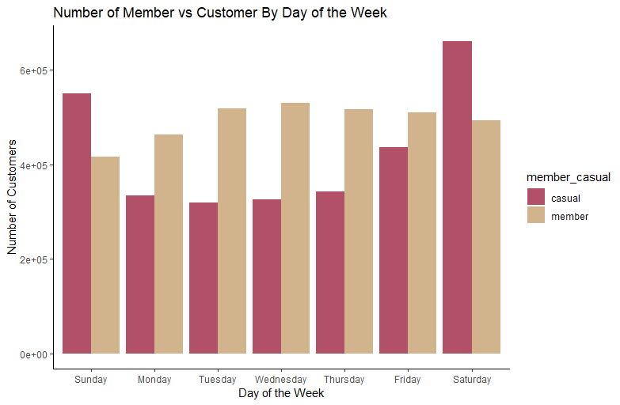
No. of rides by day of the week
Casual riders prefer weekends over weekdays for a ride.
Annual members are most active on Wednesday.

Slide 6
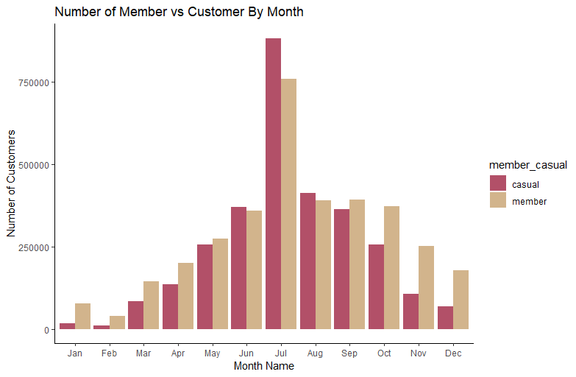
Monthly User Traffic
Annual members and Casual riders both prefer Summer season.
lowest traffic occurs from November - March.

Slide 7
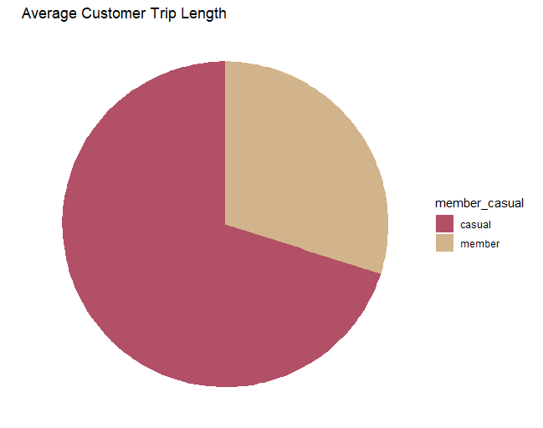
Average customer ride length comparison
Almost 60% ride length is covered by Casual riders.

Slide 8
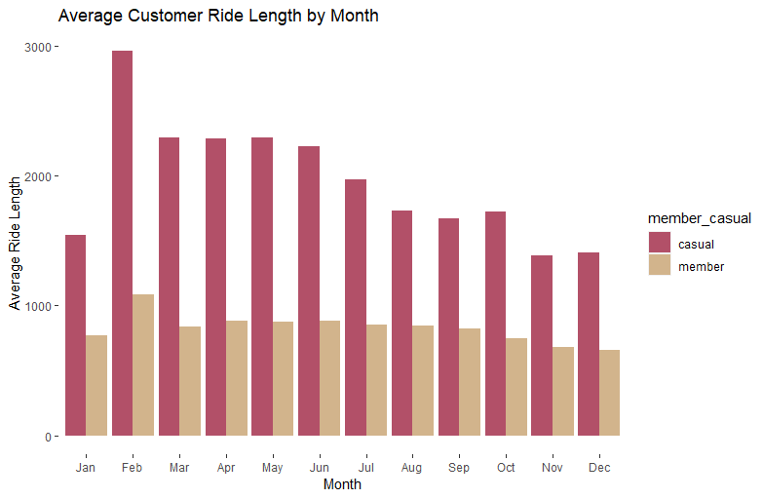
Average ride duration by month
Casual riders ride for longer duration.
Annual members ride duration is evenly spread throughout the year.
Casual riders rides for longer duration from Feb – May.

Slide 9
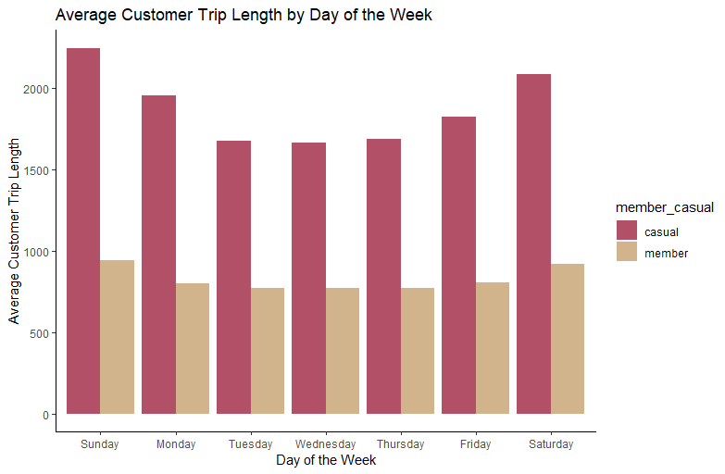
Average ride duration by week day
Casual riders rides longer than Annual members with an increase on weekends.

Slide 10
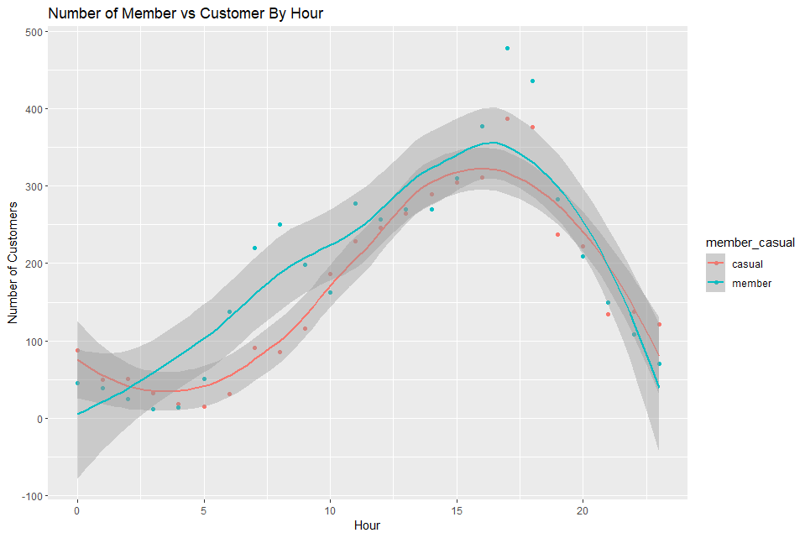
No. of rides per hour
The maximum demand of bikes is between 4:00pm – 6:00 pm.
annual members use more bikes compare to casual riders between 5:00am – 9:00am in the morning.

Slide 11
SUMMARY OF ANALYSIS
Casual riders prefer weekends and rides longer than annual members and with an increase on weekends.
Annual members and casual riders both prefer summer season. Highest no. of rides are from June – August and lowest rides occurs from Nov – March.
Annual riders trip duration is approximately even throughout the year, whereas casual riders riding bikes for longer duration from Feb – May.

Slide 12
RECOMMENDATIONS
Marketing team should launch a campaign to create flexible packages for members based on season or day of the week. For example, weekday vs. weekend membership to help attract casual riders.
For casual riders, create a limited time deal for a membership discount. This could be sign up for a membership and get your first month free or a discount program on annual membership during peek months from June – August.
Host fun biking competitions with prizes at intervals for members on the weekends. Since there are lot of casual riders on weekends this will also attract them to get a membership.
Design an application for annual members providing details of stations, routes and nearby places to grab the attention of casual riders.

Slide 13


THANK YOU
GitHub - https://github.com/spdhgithub
Linkedin - www.linkedin.com/in/spandey-ba419919a

